Slide 1
Introduction

Slide 2
Who Am I?
Dr. Ahsanur Rahman
Assistant Professor, ECE, NSU
B.Sc. in CSE from BUET
PhD in CS from Virginia Tech, USA
Website: https://sites.google.com/site/rahmanmahsanur/

Slide 3
Who are you?

Slide 4
How to contact me?
Best way: meet me during my office hours
  Office: SAC 914
  What to do if I am not there?
    If there is no sticky note on my door, then I am nearby
    If there is a sticky note, then I am probably busy in a meeting or so, as mentioned therein
  Where is my office hours?
    In front of my door and in piazza.com (discussed next)
Email: ahsanur.rahman@northsouth.edu

Slide 5
How to contact me?
Message me via Piazza.com
You need to join your class in piazza.com first
  Institution: North South University
  Piazza class-name:
  CSE 225.1: CSE225-sec1 (Data Structures)
  Access code: cse225
  Term: Summer 2018
Use first & last name that matches those with your NSU first+last names
Use your most frequent email in piazza.
Because I use piazza for ALL notices and you will get notified by piazza via email

Slide 6
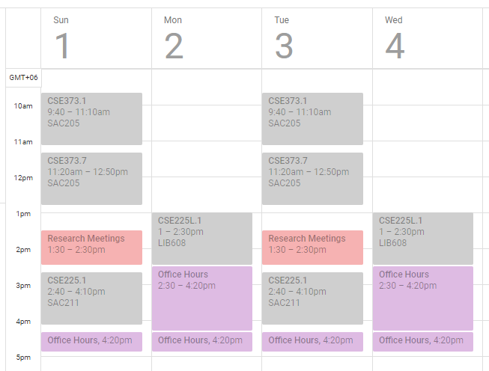
My Timetable of This Semester

Slide 7
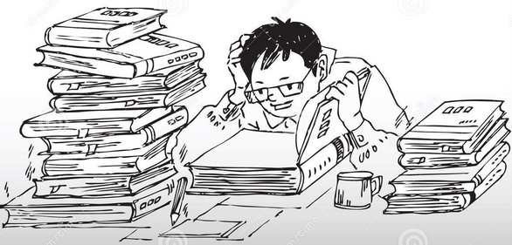
Mutual Responsibilities
Yours: keep motivated & study hard!!!
Mine: teaching and grading fairly

Slide 8
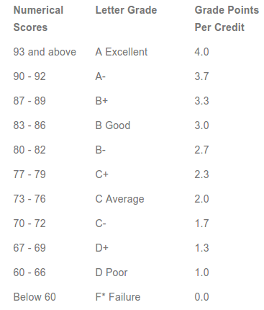
Grading system

Slide 9
Breakdown of Score
Class participation (CP) – 5%
  Bonus marks for extra-ordinary performance in class
Quizzes – 20%
Assignments/Homeworks – 5%
Midterm – 25%
Final exam – 25%
Lab work – 20% (for those whose lab is non-credit)
  This component will be ignored and the rest 80 marks will be converted to 100 for those who have credit labs to determine their theory scores & grades; their lab grades will be determined independently based on lab works

Slide 10
Midterms & Final exam
Tentative schedule:
  Midterm: after about 10 classes
  Final: after all 24 classes
Exact schedule will be announced later
Exam paper checking policy:
  Write answers to the point
  Partial marks are given to answers that are partially correct
  Don’t write something you don’t know (totally guess)
    Negative marks for guesswork

Slide 11
Ground rules for the exams
Nobody is allowed to use any electronic device (phone/tab/…) except simple calculator
  Calculator within mobile phone is not allowed
  All electronic devices must be kept off and must be kept in the bag during exam
  Turn off all your alarms in your devices
  Put bags in front of the exam hall before exam
Nobody can go outside the exam-room during the exam. Go beforehand.
Nobody is allowed to exchange anything with anybody else

Slide 12
Ground rules for the exams
Nobody can talk, move, try to look at others papers – no cheating!
Question & answer scripts will be distributed to all and a few minutes will be given before the exam starts
  Write ID, name etc. and read & understand questions during this time
    -1 mark for not writing name/id/sec
  The invigilator will ask the students if they have any question/confusion about question, in which case he will explain it. Then the exam starts

Slide 13
Ground rules for the exams
Keep totally quiet during the exam
  No question can be asked
  No request can be made
Invigilators have the right to take away anybody's paper and keep it indefinitely as well as can deduct marks if the student adopts any unfair means
Invigilators will collect signatures from the students during exam

Slide 14
Ground rules for the exams
When the invigilator tells the students to stop, everyone must stop writing, check if s/he put down his/her id, name, etc. and submit
At the end, all the question/answer-sheets will be collected.
After collecting the papers, invigilators will ensure that the number of students in the attendance sheet is the same as the number of papers+questions collected

Slide 15
Exam Paper Return Policy
I return almost all your exam papers (including quiz) in class so that you know your mistakes and your scores. Please write down your score and return the paper to me.
After mid, I upload an Excel sheet in piazza mentioning all your scores so far. I keep updating & uploading it later on.
Please verify that your scores in Excel sheet are indeed correct by matching those with the scores you know from returned papers.

Slide 16
Class participation
Based on the number of classes attended
  Physically &
  Mentally
Do
  ask questions
  answer my questions
    Earn bonus by answering correctly & quickly
    Bonus marks (0.1 ~ 1) depends on the question complexity
  Focus on what I am saying
  Take good preparation

Slide 17
Class participation
Must have >=50% attendance to pass.
Don't
  be late in class
  use cell-phones/gadgets during class
    50% attendance deduction for ringing phone
  talk to each other
  create nuisance
    100% attendance deduction for slapping each other or misbehaving, in general
  misguide/misinform me

Slide 18
Homework
Best (N-1) will be counted (N=#of HW)
Do
  Think about logic & math yourself
  write yourself
  Must be hand-written (typed won’t be accepted)
Don't
  copy/cheat
    Negative marks for copying/sharing homeworks
  forget to write down your name, id, course-id, …
  Be late
    late submissions will be given 50~10% marks
NO MAKE-UP/EXTRA Home-work!!!

Slide 19
Quizzes
N=4 ~ 6 quizzes will be taken
Marks of the best (N-1) will be counted
Exact schedule will be announced later
NO MAKE-UP QUIZZES!!!
  Even if I allow make-up in dire situations
    Students must give proof of dire situation
    The question becomes harder than the original
  Applicable for all: mid/final/quiz

Slide 20
Quizzes
Do
  Take good preparation
Don't
  copy/cheat
  forget to write down your name, id, sec
    -1 for miss any of these
  delay in submitting

Slide 21
Key to success
study regularly throughout the semester
follow the topics/problems discussed in the class
follow the DO's and avoid the DONT's mentioned here

Slide 22
Course Outcome
CO Description | POs | Bloom’s taxonomy domain/level | Delivery methods and activities | Assessment tools
Identify abstract data structures design techniques. | a | Cognitive/ Apply | Lectures/notes | quiz/exam
Use more advanced data structures for appropriate problems. | a | Cognitive/ Analyze | Lectures/notes | homework
Apply appropriate data structures to solve real world problems. | c | Cognitive/ Apply | Lectures/notes | quiz/exam
Use programming tools to write and debug codes for abstract data types. | e | Psychomotor/ Precision | Lectures/notes/ lab | quiz/exam/lab

Slide 23
Good Luck!

